Slide 1
Review II
Session 26
Henry Lucky, S.Kom. M.Kom.

Slide 2
Outline Materials
Session 04
Dynamic programming
Graph
NP-Completeness
Approximation algorithms

Slide 3
Solving recurrences

Slide 4
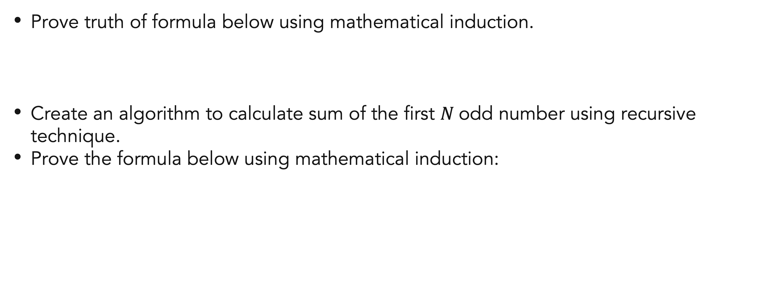
Exercises
Mathematical induction
Prove truth of formula below using mathematical induction.
Create an algorithm to calculate sum of the first $N$odd number using recursive technique.
Prove the formula below using mathematical induction:

Slide 5
References
Thomas H. Cormen. (2022). Introduction to algorithms: Fourth edition. The MIT Press. Chapter 3.

Slide 6
Thank you
Mathematical Induction And Recursive Function
September, 2023

